Slide 1
Adaptive Cloud Simulation Using Position Based Fluids
Charles Welton Ferreira Barbosa
Yoshinori Dobashi
Yamamoto Tsuyoshi
Hokkaido University

Slide 2
Overview
Introduction
Related Work
Proposed Method
Results
Conclusion

Slide 3
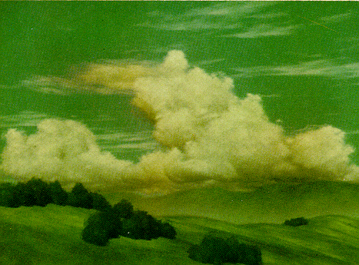
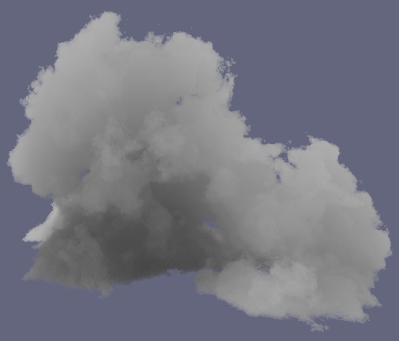
Introduction
Visual simulation of clouds
synthesizing images of outdoor scenes
flight simulators, movies, computer games, etc
procedural or physically-based approaches
[Gardner 1985]
[Schpok 2003]
[Dobashi00]
[Miyazaki02]

Slide 4
Introduction
Physically-based approach
realistic shapes and motions
simulation of atmospheric fluid dynamics
grid-based methods only
[Gardner 1985]
[Schpok 2003]
[Dobashi00]
[Miyazaki02]

Slide 5
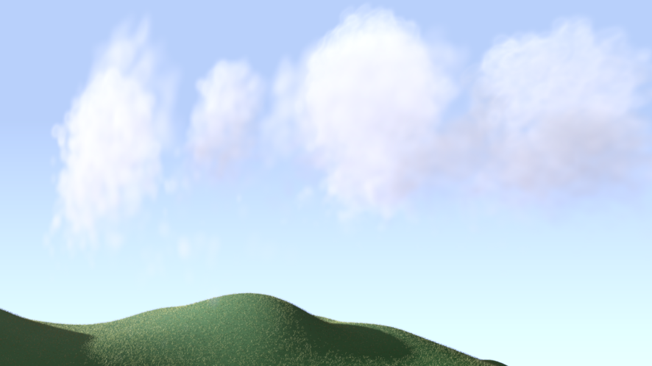
Our Goal
Particle-based simulation of clouds
position-based fluids + cloud dynamics
adaptive simulation
efficient simulation using GPU
example images by our method

Slide 6
Overview
Introduction
Related Work
Proposed Method
Results
Conclusion

Slide 7
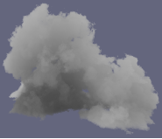
Related Work
Procedural approach
Fractals [Voss83]
Textured ellipsoids [Gardner85]
Metaballs + noise function [Ebert97]
Spectral synthesis [Sakas93]
Real-time modeling/rendering system [Schpok03]
[Garder85]
[Ebert97]
[Schpok03]

Slide 8
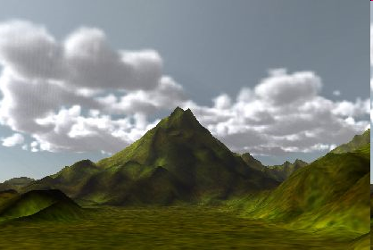
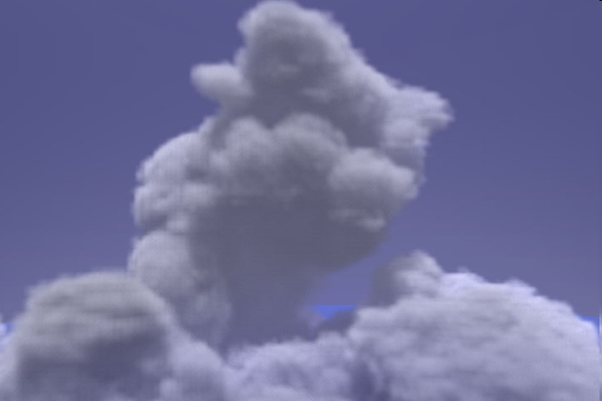
Related Work
Physically-based approach
Numerical solution of atmospheric fluid dynamics [Kajiya84, Miyazaki01, Miyazaki02, Dobashi08]
No particle-based methods
[Miyazaki01]
[Miyazaki02]
[Dobashi08]

Slide 9
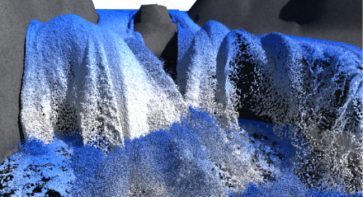
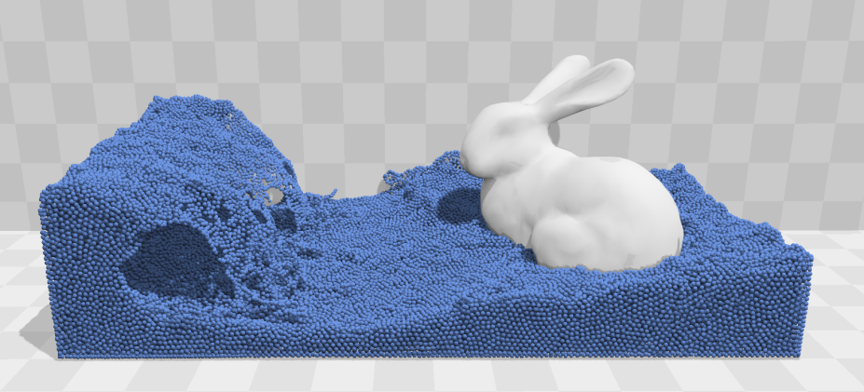
Related Work
Particle-based methods for fluids
Smoothed particle hydrodynamics (SPH) [Muller03, Solenthaler09, Ihmsen14]
Position-based fluids (PBF) [Muller07, Macklin13, Macklin14]
We use PBF for simulating clouds
[Cornelis14]
[Macklin13]

Slide 10
Overview
Introduction
Related Work
Proposed Method
Results
Conclusion

Slide 11
Proposed Method
Overview of cloud formation process
Simulation method
Adaptive particles

Slide 12
Overview of Cloud Formation Process
Ground is heated by the sun.
Notes:
The cloud formation process is as follows.
First, when there are no clouds, the ground is heated by the sun, as shown in this figure.

Slide 13
Overview of Cloud Formation Process
Air parcels start to move upward.
buoyancy
force
air parcels
Notes:
Next, due to the heat from the ground, the air near the ground starts to move upward due to the thermal buoyancy forces.

Slide 14
Overview of Cloud Formation Process
Temperature of air parcels decreases.
adiabatic
cooling
Notes:
As the air parcels move upward, their temperature decreases.
This phenomenon is called an adiabatic expansion or cooling.

Slide 15
Overview of Cloud Formation Process
Clouds are generated due to phase transition
phase transition
(vapor cloud)
Notes:
Next, at a certain altitude, the phase transition occurs, that is, the water vapor in the air parcels become water droplet, or clouds, as shown in this figure.

Slide 16
Overview of Cloud Formation Process
latent heat is
liberated due to
phase transition
phase transition
(vapor cloud)
Notes:
At the same time when the phase transition occurs, so-called latent heat is librated.
This phenomena is very important for the cloud formation.

Slide 17
Overview of Cloud Formation Process
latent heat is
liberated due to
phase transition
phase transition
(vapor cloud)
additional buoyancy
Notes:
Because the latent heat creates additional buoyancy forces.

Slide 18
Overview of Cloud Formation Process
latent heat is
liberated due to
phase transition
phase transition
(vapor cloud)
additional buoyancy
further cloud growth
Notes:
This buoyancy forces promote the cloud growth further into higher regions.
Our method synthesize the desired shape of the clouds by controlling the amount of this latent heat.

Slide 19
Proposed Method
Overview of cloud formation process
Simulation method
Adaptive particles

Slide 20
Simulation Method
simulation space

Slide 21
Simulation Method
boundary particles
simulation space
(periodic boundary)
(periodic boundary)
boundary particles

Slide 22
Simulation Method
boundary particles
simulation space
position, p
mass, m
velocity, (u_{x}, u_{y})
temperature, T
vapor density, v
cloud density, w
position-based fluids
(periodic boundary)
(periodic boundary)
cloud formation
boundary particles

Slide 23
Simulation Method
Processes during a single time step
1. heat from the ground
2. buoyancy force
3. adiabatic cooling
4. phase transition
5. latent heat
6. update particle positions with PBF

Slide 24
1. Heat from the Ground
Increase temperature of particle i near ground:
temperature
temperature of
external heat source
time

Slide 25
2. Buoyancy Force
Buoyancy force for particle i :
temperature
ambient temperature
cloud density
thermal buoyancy
gravity
k_{b}, k_{g} : user-specified coefficients
z : unit vertical vector

Slide 26
3. Adiabatic Cooling
Decrease temperature of particle i:
temperature
dry adiabatic lapse rate
(user-specified)
vertical speed of particle i
time

Slide 27
4. Phase Transition
Update cloud/vapor density of particle i:
cloud density
α : phase transition rate
vapor density
γ_{i} : saturation vapor

Slide 28
5. Latent Heat
Update temperature of particle i :
latent heat coefficient
(user-specified)
temperature
amount of clouds generated by phase transition

Slide 29
6. Update Particle Positions with PBF
Modify particle positions to satisfy :
solved by using the Taylor’s expansion (see [Macklin13] for details)
density of particle i
rest density
particle positions

Slide 30
Simulation Method
Processes during a single time step
1. heat from the ground
2. buoyancy force
3. adiabatic cooling
4. phase transition
5. latent heat
6. PBF

Slide 31
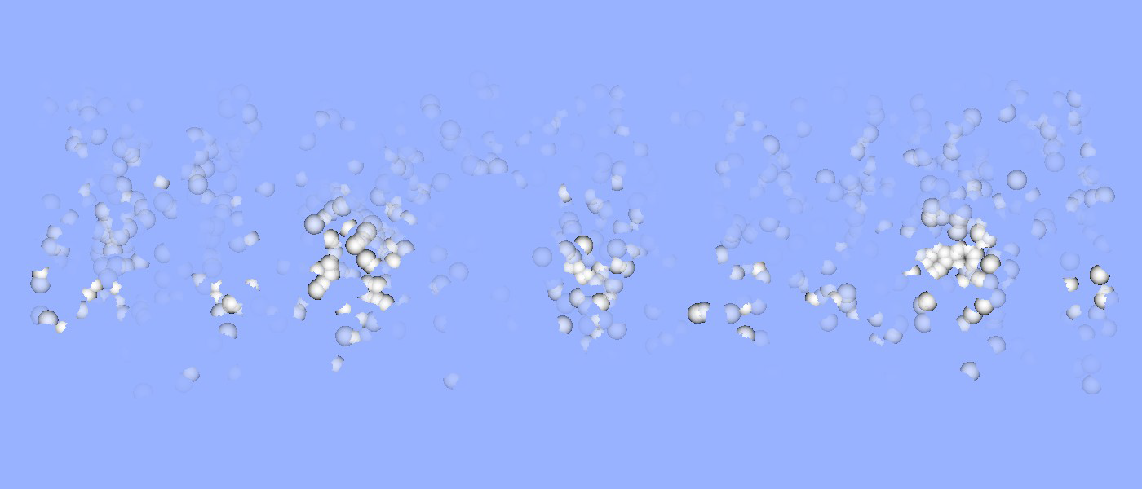
Experimental Result (2D)
Scattered and unrealistic clouds
Smoothing of temperature field

Slide 32
7. Smoothing of Temperature Field
Update temperature to satisfy smooth constraint:
solved by using the Taylor’s expansion (see paper for details)

Slide 33
Experimental Result (2D)
Obtained smoothed and better results
without smoothing
with smoothing

Slide 34
Proposed Method
Overview of Cloud Formation Process
Simulation method
Adaptive particles

Slide 35
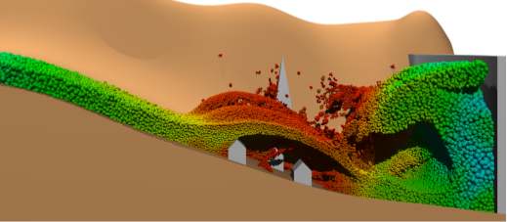
Adaptive Particles
Split and merge particles where necessary
Energy function for split/merge determination
We use [Adams07] for split/merge processes
GPU implementation
[Adam07]

Slide 36
Energy Function
Areas of interest : cloud regions
split where clouds are generated
merge where clouds disappear
Simple energy function using cloud density:
cloud density
user-specified coefficient

Slide 37
Energy Function
cloud forming, split
E (shape energy)
user-specified thresholds
no clouds, merge
w_{i} (cloud density)

Slide 38
GPU Implementation
Split : straight forward
Merge : incorrect merging

Slide 39
GPU Implementation
Split : straight forward
Merge : incorrect merging

Slide 40
GPU Implementation
Split : straight forward
Merge : incorrect merging
independent
merging

Slide 41
GPU Implementation
Split : straight forward
Merge : incorrect merging
thread 1
thread 2
thread 3

Slide 42
GPU Implementation
Split : straight forward
Merge : incorrect merging
thread 1
thread 1
thread 2
thread 3

Slide 43
GPU Implementation
Split : straight forward
Merge : incorrect merging
thread 1
thread 1
thread 2
thread 2
thread 3

Slide 44
GPU Implementation
Split : straight forward
Merge : incorrect merging
thread 1
thread 1
thread 2
thread 2
thread 3
thread 3

Slide 45
GPU Implementation
Split : straight forward
Merge : incorrect merging
thread 1
thread 1
thread 2
thread 2
independent
merging
thread 3
thread 3

Slide 46
GPU Implementation
Use of grid to avoid incorrect merging

Slide 47
GPU Implementation
Use of grid to avoid incorrect merging

Slide 48
GPU Implementation
Use of grid to avoid incorrect merging
generate threads for each red cell

Slide 49
GPU Implementation
Use of grid to avoid incorrect merging
generate threads for each red cell
select single particle inside each cell and merge it

Slide 50
GPU Implementation
Use of grid to avoid incorrect merging
move to the next cells

Slide 51
GPU Implementation
Use of grid to avoid incorrect merging
select single particle inside each cell and merge it

Slide 52
GPU Implementation
Use of grid to avoid incorrect merging
move to the next cells

Slide 53
GPU Implementation
Use of grid to avoid incorrect merging
select single particle inside each cell and merge it
repeat several times

Slide 54
GPU Implementation
Use of grid to avoid incorrect merging

Slide 55
Experimental Result (2D)
cloud density

Slide 56
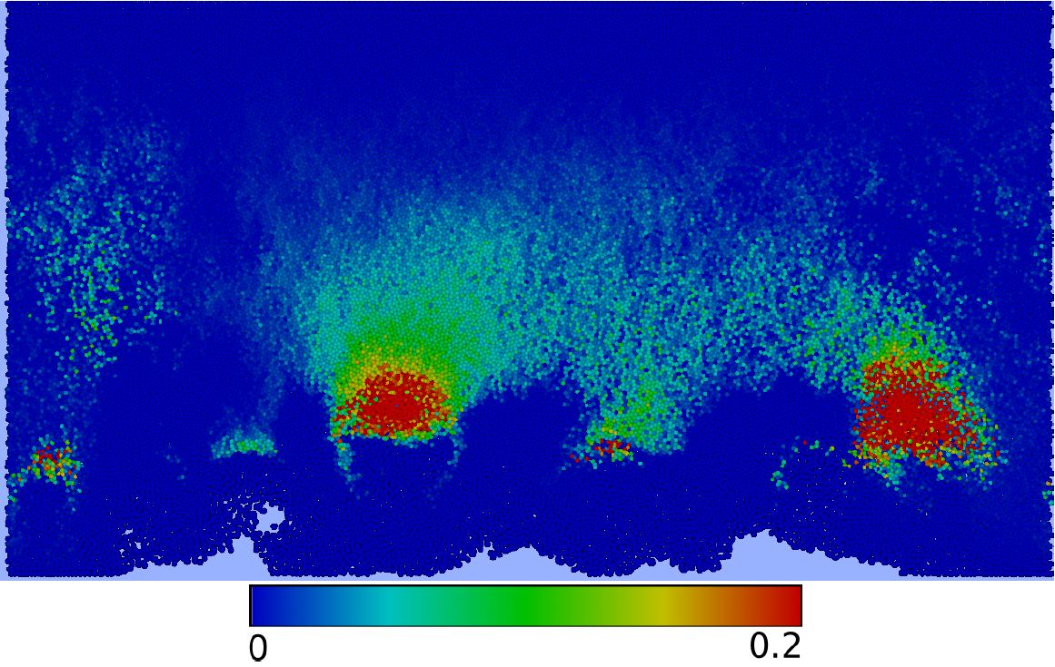
Experimental Result (2D)
energy function

Slide 57
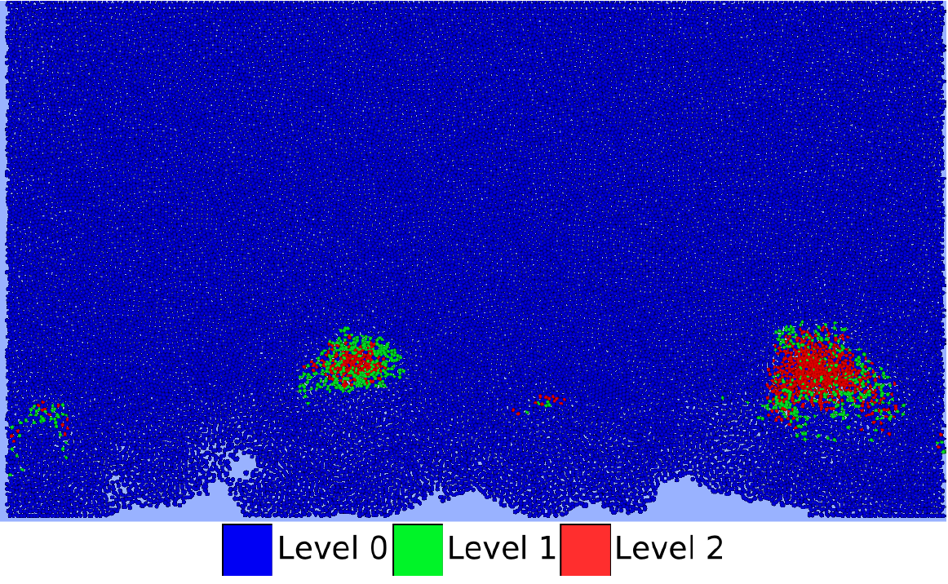
Experimental Result (2D)
subdivision level

Slide 58
Overview
Introduction
Related Work
Proposed Method
Results
Conclusion

Slide 59
Results
Computer
CPU: Corei7-4770K, 16 GB memory
GPU: NVIDIA GeForce GTX 780 Ti
Rendering
mental ray (Autodesk MAYA 2014)

Slide 60
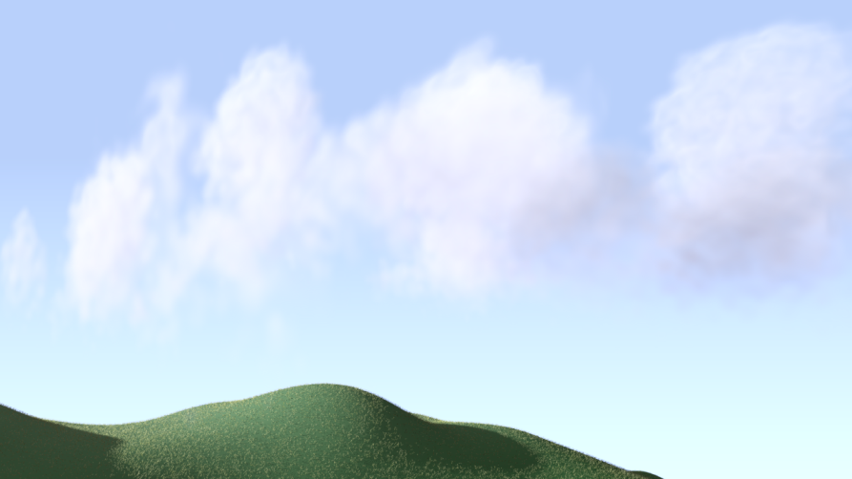
Results
non adaptive
adaptive
Example 1
840k particles
540k particles
Example 2
930k particles
500k particles
video

Slide 61
Results
Average performance for single time step
 | PBF | Smoothing | Cloud Dynamics | Split/ Merge | Total
Ex. 1 (w/o adaptive) | 1087 | 112 | 19 | - | 1218
Ex. 1 (w adaptive) | 629 | 65 | 13 | 30 | 737
Ex. 2 (w/o adaptive) | 1292 | 137 | 20 | - | 1449
Ex. 2 (w adaptive) | 749 | 72 | 14 | 31 | 866
[milliseconds]

Slide 62
Results
Average performance for single time step
 | PBF | Smoothing | Cloud Dynamics | Split/ Merge | Total
Ex. 1 (w/o adaptive) | 1087 | 112 | 19 | - | 1218
Ex. 1 (w adaptive) | 629 | 65 | 13 | 30 | 737
Ex. 2 (w/o adaptive) | 1292 | 137 | 20 | - | 1449
Ex. 2 (w adaptive) | 749 | 72 | 14 | 31 | 866
1.6x faster when using adaptive method
[milliseconds]

Slide 63
Conclusions/Future Work
Particle-based cloud simulation
position-based fluids
smoothing of temperature field
adaptive method
GPU implementation
Future Work
detailed shapes and motions

